Slide 1


Recap session

Slide 2



CONTROL DIAGRAMS
Flowchart
State machine
Sequence
- flexible and intuitive
- presentable layout
- suitable for business rules
- complex high level process structure
- exception handling and recovery
-error reporting
- structured execution
- suitable for UI interaction
- small UI/data decisions

Slide 3
CONTROL FLOW – COMMON ACTIVITIES
Flowchart Activities
Flow Decision – Simple decision node to be used in a flowchart to branch the diagram based on a condition being True or False
Flow Switch – Matches the result of an expression with a set of maximum 12 cases
Sequence Activities
If – Does the same thing as Flow Decision, but in a sequence
Switch – Matches the result of an expression with a set of cases
Do While – Executes action inside, then keeps going until the condition is met
Parallel – Executes each activity inside of it at once
While – Checks if condition is met. If not, it will keep executing actions until the condition is met
For Each – Iterates over items in a list and performs an action on each one
Break – Put inside a For Each activity to end it prematurely

Slide 4

VARIABLE TYPES
Different variable data types:
String – Any text - combination of symbols and letters in quotation marks
e.g. “Hello World!” , “AG221fk”
int32 – Generic variable type for any integer
e.g 12, 44120
Double - floating point number
e.g. 33.34, 842.01
DateTime – Represents year, month and day
e.g. new DateTime(2015, 12, 25), today
Boolean – Logic value of either True or False
DataTable – Stored data in the format of a generic table
Generic Value – Versatile data type that can hold a number, string or date

Slide 5
STRING METHODS
Format
String.Format(“Downloads/Folder{0}/output.txt”,”10”) → “Downloads/Folder10/output.txt”
Substring
(“Downloads/Folder10/output.txt”). Substring(10) → “Folder10/output.txt”
Split
(“Downloads/Folder10/output.txt”). Split(“/”.ToCharArray) → “Downloads”, “Folder10”, “output.txt”
ToLower/ToUpper
(“Downloads”).ToLower → downloads (“Folder10”).ToUpper → FOLDER10
Contains
(“output.txt”).Contains(“.”) → TRUE (“output.txt”).Contains(“/”) → FALSE
EndsWith/StartsWith
(“Downloads/Folder10/output.txt”).EndsWith(“.txt”) → TRUE
Replace
(“Downloads/Folder10/output.txt”).Replace(“/”,”*”) → “Downloads*Folder10*output.txt”
Trim/TrimStart/TrimEnd
(“ Downloads/Folder10/output.txt ”).Trim → “Downloads/Folder10/output.txt”

Slide 6
SELECTORS
Full selectors
Contain all the elements needed to identify a UI element, including the top-level window
Generated by the Basic recorder
Recommended when switching between multiple windows
Partial selectors
Generated by the Desktop recorder
Do not contain information about the top-level window
Activities containing partial selectors are enclosed in a container (Attach Browser or Attach Window) that contains a full selector of the top-level window
Recommended when performing multiple actions in the same window

Slide 7
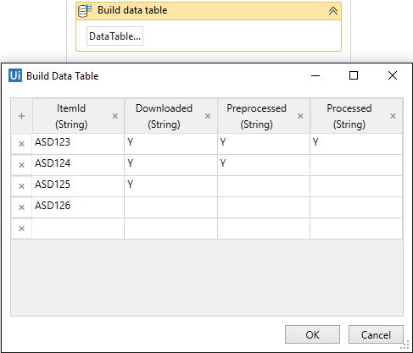
CONFIGURE A NEW DATATABLE
1. Build Data Table wizard
+ sign to add a new column in the DataTable
- set the column name
- set data type it can store
x sign to delete the column
you can manually add your data in the rows
2. dt.Clone
creates a new table with the same structure as an existing dt table without the data in it
3. Generate Data Table
you can create a table out of tabular formatted text

Slide 8
ACCESS MODES
 | Excel Application APIs | Direct File Access APIs
Works without MS Office? | No | Yes
Works with file open? | Yes, both opened and closed | No
Works with xls files? (older than Office 2007) | Yes | No, only new format (xlsx, xlsm, xlsb)
Needs a container for its activities? | Yes, Excel Application Scope | No
Works with macros and Excel tables? | Yes | No

Slide 9
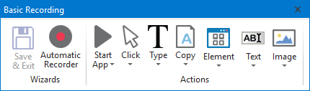
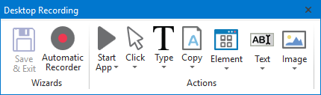
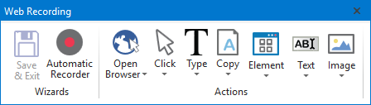
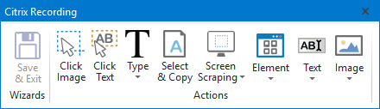
RECORDING PROFILES
Basic Recording
Desktop Recording
Web Recording
Citrix Recording

Slide 10
BASIC VS DESKTOP RECORDING
Generates a full selector for each activity and no container
Slower than the workflow that uses attach containers
Use it when you have to do one activity per window
Recorder generates an Attach Window container with the
window selector
Generates a partial selector for the activities inside attach
Runs faster than the
Basic recording
Optimal for doing more than
one action/ container
BASIC
DESKTOP

Slide 11
UI ACTIVITIES PROPERTIES
TimeoutMS
(in Milliseconds) – how much does it wait to find the element before throwing an error
WaitForReady
wait for the whole page to load or not
Common Properties
ContinueOnError
continues even if it doesn’t find the element
Target
identifies the element we are running the activity on
DelayAfter
adds a pause after the action is executed (in Milliseconds)
Specific
dependent on the specific role of an UI element
DelayBefore
adds a pause before the action is executed (in Milliseconds)

Slide 12
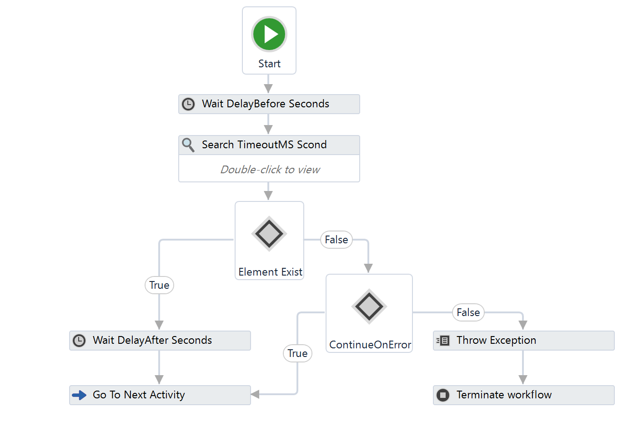
UI ACTIVITIES TIMELINE

Slide 13
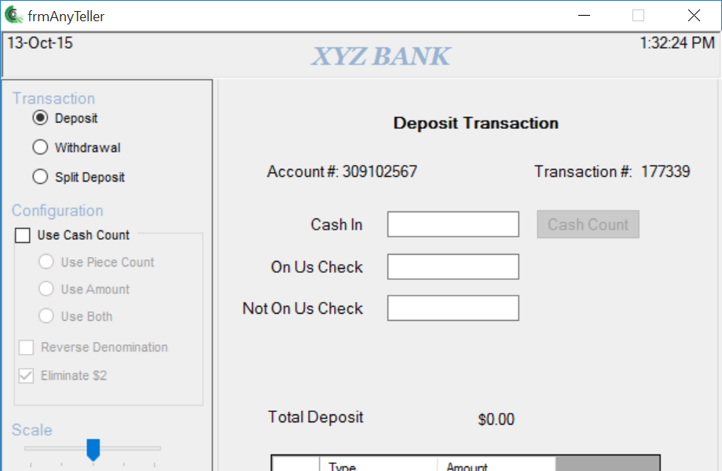
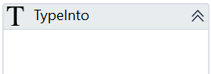
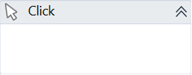
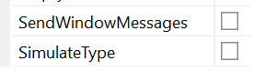
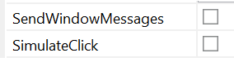
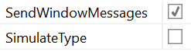
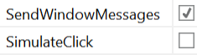
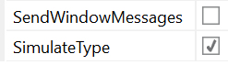
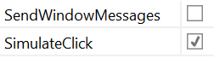
INPUT METHODS – WHAT THEY TARGET
OS
Mouse driver
Keyboard driver

Slide 14
INPUT METHODS - COMPARISON
 | Uses the driver | Uses OS Window Messages | Uses software’s tech | Can add hotkeys | Works in background | Application needs to be in foreground
Hardware events
Window Messages
Simulate Type/Click

Slide 15
OUTPUT METHODS - SCREEN SCRAPING
 | Speed | Accuracy | Works in Background | Gets text position | Gets hidden text | Works with Citrix
Full Text | fastest | 100%
Native | fast | 100%
OCR | slow | 98%*

Slide 16
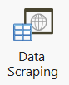
DATA SCRAPING
Lists
Correlated data
Tables
Is a fast atomic way of extracting structured data from the web, PDF, java apps, SAP, even paginated data
You can use the Data Scraping wizard
or Extract Structured Data activity (for experts)

Slide 17
BACKGROUND AUTOMATION OVERVIEW
 | Background Robot doesn’t bother user | Foreground Robot needs the control for a while
Input | Simulate type/click Window Message Check (a checkbox) Select Item (from a listbox) Set Text | Default (hardware event) Using a clipping region Paste (From clipboard)
Output | Full text Get text Data scraping | Native OCR Copy Selected Text

Slide 18
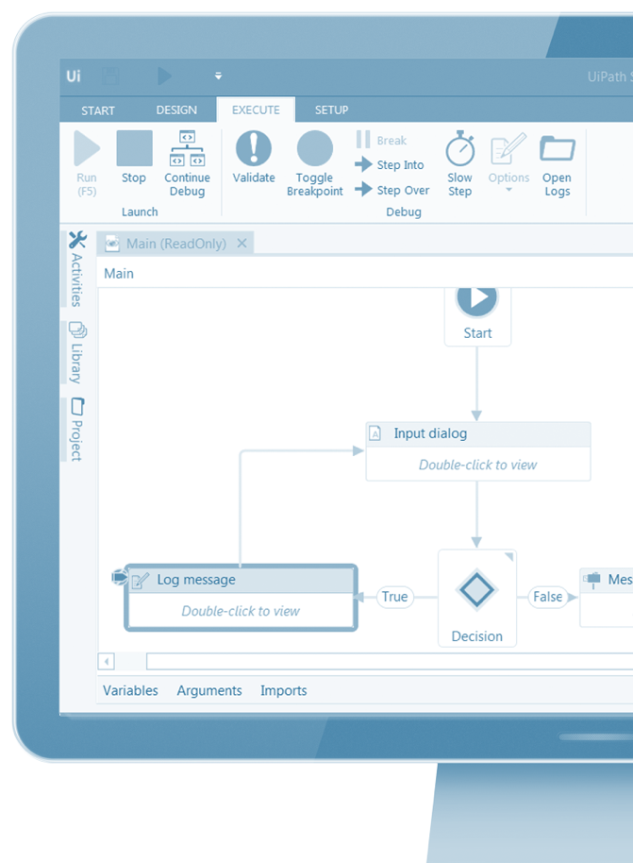
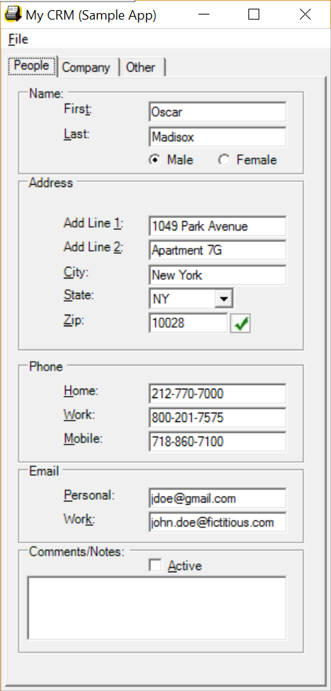
MEANING OF THE STRUCTURE
<wnd app='winforms_ratchetx.mycrm_x86.exe' ctrlname='Form1' />
<wnd ctrlname='tabControl1' />
<wnd ctrlname='tabPagePeople' />
<wnd ctrlname='groupBox5' />
<wnd ctrlname='textBoxPeopleFirstName' />

Slide 19
TAGS AND ATTRIBUTES
<webctrl parentid='slide-list-container' tag='A' aaname='Details' class='btn-dwnl' />
Tags
nodes in the selector XML fragment
represent a visual object on screen
first node is the app window
last one, the element itself
Attributes
Every attribute has a name and a value
Use only attributes with constant or known values
parentid='slide-list-container' aaname='Details‘
tag='A‘
class='btn-dwnl'
Might be:
wnd (Window)
html (Web page)
ctrl (Control)
webctrl (Web page control)
java (Java application control)

Slide 20
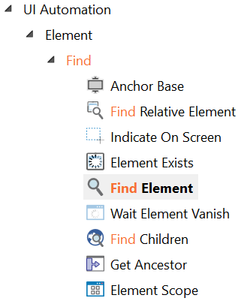
FINDING ELEMENTS
Most used activities for finding elements
Find Element
finds a particular element and saves it
returns a UI Element variable if the element is found
throws an error if the element is not found
Element Exists
checks if an element exists based on its selector
returns a Boolean variable with the answer True / False
Find Children
retrieves a collection of elements at once
you can setup a flexible filter for elements properties

Slide 21
REVIEW ALTERNATIVE METHODS - INPUT
 | Input
 | Click | Type
Image | Click Image | Click Image (with offset) + Type Into
Text | Click (OCR) Text | Click (OCR) Text (with offset) + Type Into
Keyboard | (Tab/other) + Enter/ special key | Tab/other + Type into

Slide 22
REVIEW ALTERNATIVE METHODS - OUTPUT
 | Output
 | Selectable | Not selectable
Image | Click Image (with offset) + Select & Copy | Scrape Relative
Text | Click (OCR) Text (with offset) + Select & Copy | Find Text Position + Get OCR Text
Keyboard | Tab / special keys + Select & Copy OR Send Hotkey (CTRL+C) | -

Slide 23
OPEN APPLICATION IN CITRIX
Double click
on the Icon
Shortcut Key
Command prompt
define the image and click with Double Click Image
not very reliable (if background & resolution changes, if highlighted)
use it as fallback method, if the next two don’t work
define a shortcut key and trigger the app with a Send Hotkey activity
add arguments in the Comment section (or Target , with parameter)
the preferred way of opening apps in Citrix
open the command prompt and Type the path to the application
add the arguments after the application path
use it when creating short keys is not allowed by admin

Slide 24
HANDLING THE SCALE/ RESOLUTIONS CHANGE
Issue: In rare cases, Citrix automation based on image recognition is prone to errors due to resolution changes.
Solution: Search for multiple images, with different scales/ resolutions
Using If
Check for the images in sequential order, returns true when image exists
Using Pick Branch
Search for multiple items at the same time and executes the one it finds first

Slide 25
READ USING PDF ACTIVITIES
Read PDF Text
Read PDF with OCR
works for NATIVE .pdf docs
doesn't preserve formatting
can read the whole document or certain pages (use Range property)
runs in background
works for SCANNED .pdf docs
uses OCR engines (MODI,
Google, Abbyy)
can read the whole document
or certain pages (use Range
property)
runs in background

Slide 26
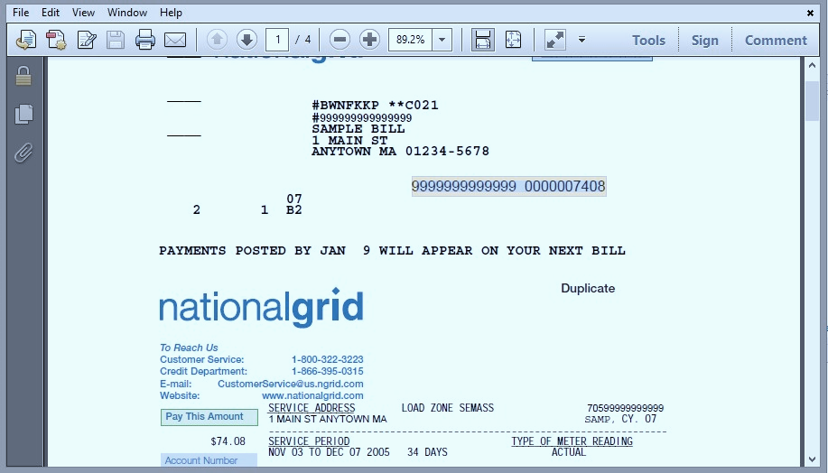
READING PDF USING UI AUTOMATION
Open Adobe Acrobat
Use Screen scraping / Get Text
keeps formatting
needs Adobe Acrobat Reader or a compatible pdf reader
can select certain fields

Slide 27

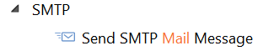
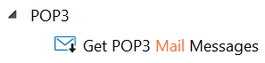


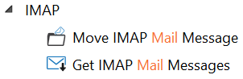
EMAIL PROTOCOLS (SMTP, POP3, IMAP)
SMTP is used for
sending out emails
POP3 & IMAP is used for retrieving emails
POP3 or IMAP
SMTP
IMAP is more customizable (can get only unread emails, mark emails as read or not )

Slide 28
MONITOR EVENTS
Helps you capture keyboard usage or mouse clicks anywhere on the screen, regardless of the application you are interacting with
system keypress events
system mouse click events
It also can monitor changes in the file system, so you can trigger events based on folders and files changes
file system events
Helps you capture keyboard usage or mouse clicks on a specific UI element that we want to monitor
element keypress events
element mouse click events
You can also monitor mouse clicks on a specific image, which can be very useful with Citrix, where we only see images
image click events

Slide 29
MONITORING SETTINGS
Monitoring properties
RepeatForever
the response is triggered only one time - first time or every time the event happens
Trigger properties
Synchronous and Asynchronous Events Capturing
in a synchronous case, UiPath’s workflow response happens before or instead of the app’s original response
in an asynchronous case, UiPath’s workflow response does not interfere with the original response and happens in parallel
Block event
stops the original response from taking place; makes sense only in Synchronous scenario

Slide 30
MONITORING SETTINGS Event Handling Activities
Replay User Event
Get Source Element
It can call the original response to the event, in cases or at times decided by our workflow
Gets the reference to the UI element that triggered the event

Slide 31
SQL STATEMENTS
Statements
Returned value
Non-Query
Insert, delete, update
Other non-query statements
Queries
Bulk insert
Number of rows affected
-1
DataTable
Number of rows affected

Slide 32
COMMAND TYPES & PARAMETERS
Statements are based on the .NET CommandType enumeration: Text Stored Procedures Table Direct – available only for OLE DB data provider Each statement can be parametrized: Define the parameters collection In the query, use @ before the name of the parameters

Slide 33

COMMON EXCEPTIONS
Object reference not set to an instance of an object.
Thrown when a variable has not been initialized (has no value). To avoid this, make sure a variable has a value before using its methods.
Index was outside the bounds of the array. Index out of range.
Thrown in an attempt to access array or collection elements with an index that is outside its capacity. Most common situation: getting an element of a list without checking if the list contains items
Cannot find the UI Element corresponding to this selector.
Occurs when the selector used to identify the control does not match any control on the screen. To debug, when this exception is thrown, you need to inspect the target application and observe if the control exists.

Slide 34
COMMON EXCEPTIONS
Image was not found in the provided timeout.
Occurs when the expected image is not identified on screen either because it is not visible in foreground or the image is slightly different due to environment settings (resolution, theme) or controls are in different state.
Text was not found.
Occurs in Text based automation activities. Text activities currently do not take into account the TimeoutMS property when searching for the text, so the text needs to be on the screen when the activity is reached.
Click generic error. Cannot use UI_CONTROL_API on this UI node. Please use UI_HARDWARE_EVENTS method.
Occurs when a click could not be executed. The most common issue is using SimulateClick or SendWindowMessages options in an application window that does not support them.

Slide 35
AUTOMATION CHALLENGES
Timing Issues
Unexpected behavior is likely to occur when the application is not in the state the workflow assumes it to be. The first thing to watch for is the time the application takes to respond to workflow interactions. Activities use the TimeoutMS and the WaitForReady properties when searching for a control so they can be used for synchronization. DelayMS should be used for activities that change the state of the application and the next activity should not be executed immediately. Measures may include using extra activities (find image, find text, element exists, wait image vanish) that wait for the desired application state before other interactions.
Input Method Issues
Each input method has its own particularities and can trigger a different behavior to the target application. How the application reacts to an input method should be considered when choosing one. Errors may appear when using one of the input method without knowing its implications.
Coordinates Issues
Coordinates are relative to the target but it’s recommended to use them as little as possible in situation where the layout of the application changes between instances. Extra measures may be needed to maintain the layout of the application.

Slide 36
UI SYNCHRONIZATION
Useful activities for checking application UI status
FindElement
ElementExists
WaitElementVanish
OnElementVanish
OnImageVanish
ImageExists
WaitImageVanish
FindOCRTextPosition
DelayBefore
DelayAfter

Slide 37
AUTOMATION STANDARDS
Reliable
Efficient
Maintainable
Extensible
Progress tracking
Exceptions handling, recovery and error reporting
Design = time well spent in development stage
Smooth execution in production environment
Clear structure and good development standards
Open for new use cases to be incorporated

Slide 38
Project Overview
Project organization starts before
opening UiPath
Input & output data
Email, folders, files, queues
Config/mapping file
Logs, reports
Applications involved
Web, desktop, Citrix
Process type
Linear or repetitive

Slide 39

STRUCTURAL GUIDELINE
Main Workflow
Flowchart
State machine
Business Logic
Flowchart
Data Processing
Sequence, VB
Powershell script
UI Interactions
Sequence
Break the process in simple workflows
Collaborate working on separate files
Develop and test pieces independently
Reuse workflows (even across projects)
Keep environment settings in dedicated file

Slide 40
BEST PRACTICES
Break the whole process in simple workflows
Develop and test pieces independently
Pick an appropriate layout for each workflow
Give meaningful names to all components (Workflows, activities, arguments and variables)
Collaborate working on separate files
Reuse workflows across projects
Keep it clean: close applications, windows, web pages
Keep environment settings in a config file

Slide 41

Q & A

